Slide 1
SEP Customer
Accessibility Testing
Nov 1st 2019
Martin Kerr
Anubhav Mittal

Slide 2
Who we tested with
5 People with mental health issues and in employment @ Taylor McKenzie Lab in Glasgow.
A Mix of Business Owners (3) and employees(2)

Slide 3
What we were trying to find out
We were interested in:
How stable SEP is when used by participants with Mental Health issues.
Starting URL: https://se-qa-singleentrypoint.azurewebsites.net

Slide 4
Summary
The site is fairly stable and most things work quite well
The only real issue is that people are not expecting the Event Links to send them to another site (usually bgatway.com), and they can become lost.
The homepage image was well received
This audience tend to take a more literal view of the site.
They read in a slower and more exact manner
Long sentences performed slightly poorer than short meaningful ones
This audience was more affected by colours
Responded well to the site being so clean. This worked so well that the site did not perform noticeably poorer with this group.
“Highlighting” text was used to give alternative contrast (Light text on a darker background)

Slide 5
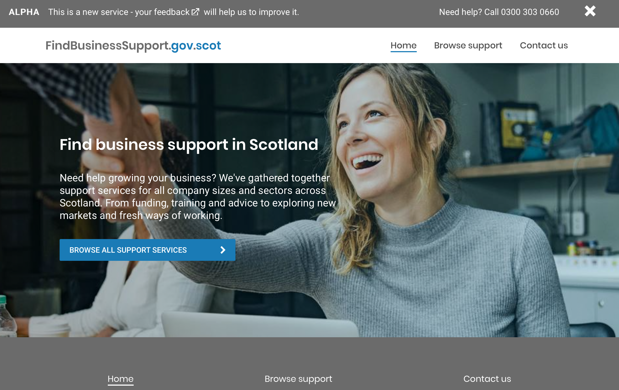
Home Page
The homepage image was well received.
The homepage was generally well received and everyone clicked the Blue CTA button and progressed into the site.
The homepage was viewed as not “Saying what it Does” clearly enough
There was some uncertainty about the site being just for startups or all companies

Slide 6
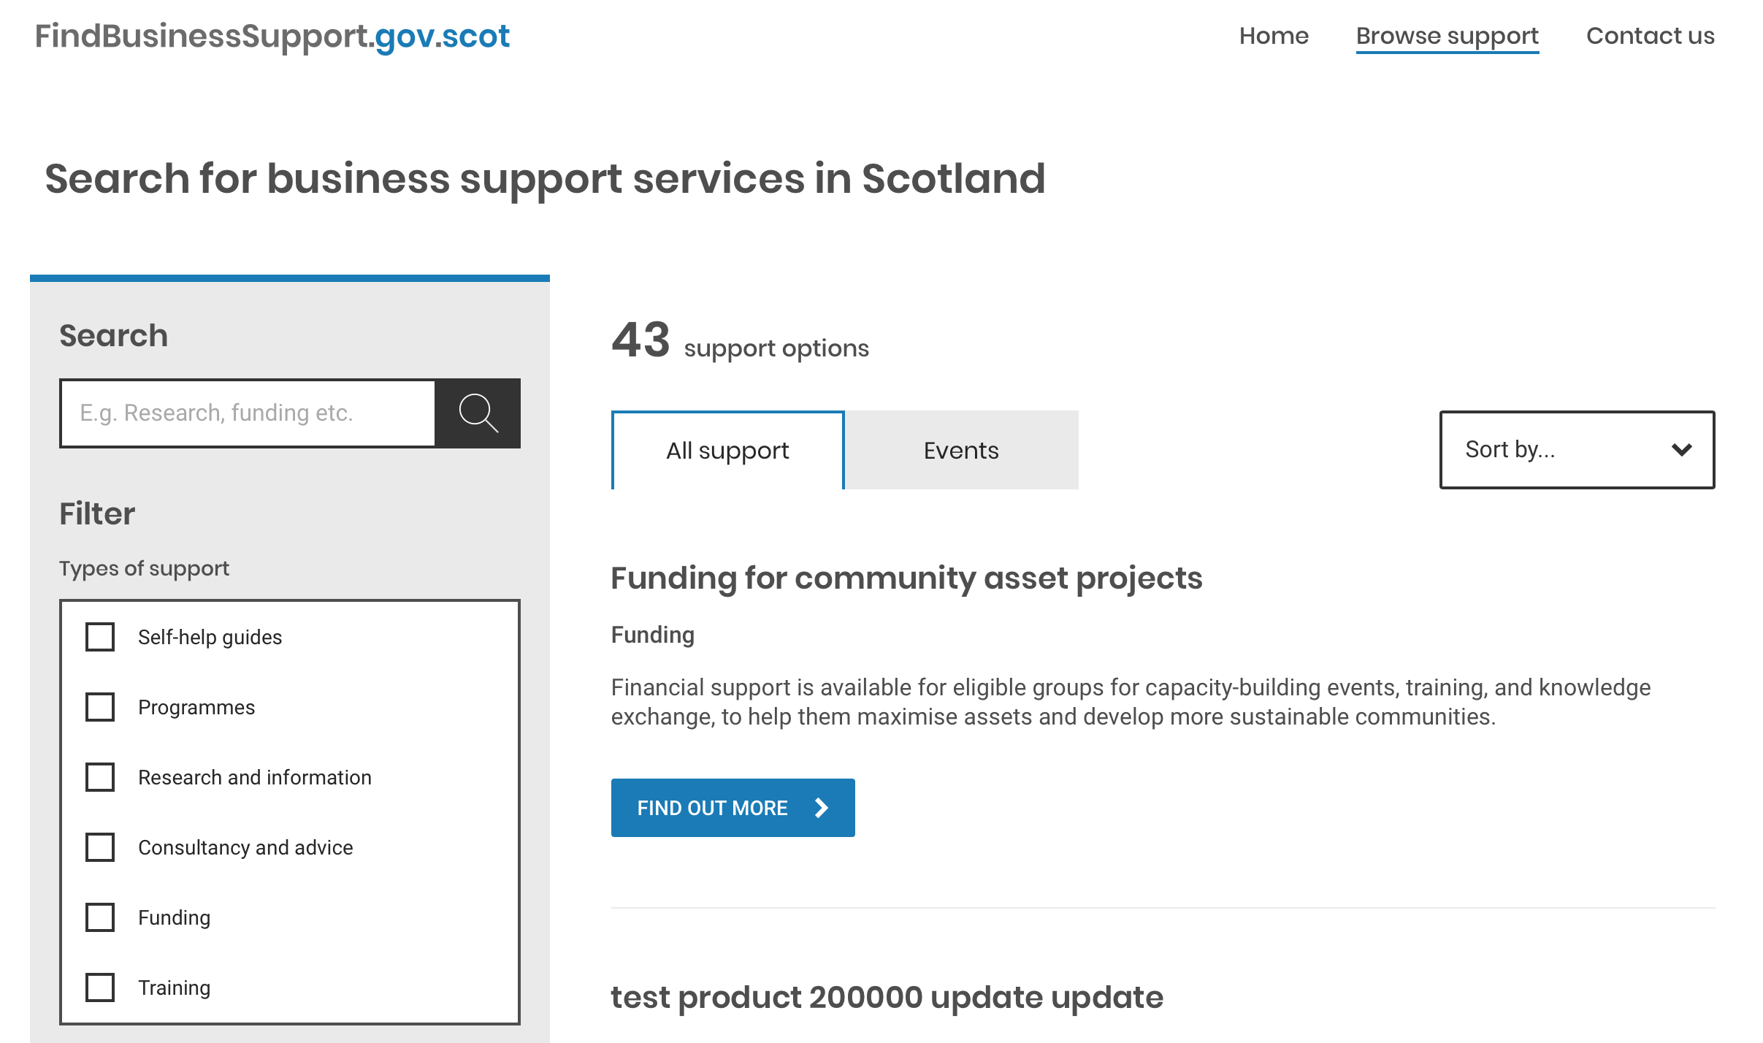
Support Listings
The service listing was well received.
Search and Filter being separated worked well.
The CTA was very clear
People were unsure about who delivered each thing

Slide 7
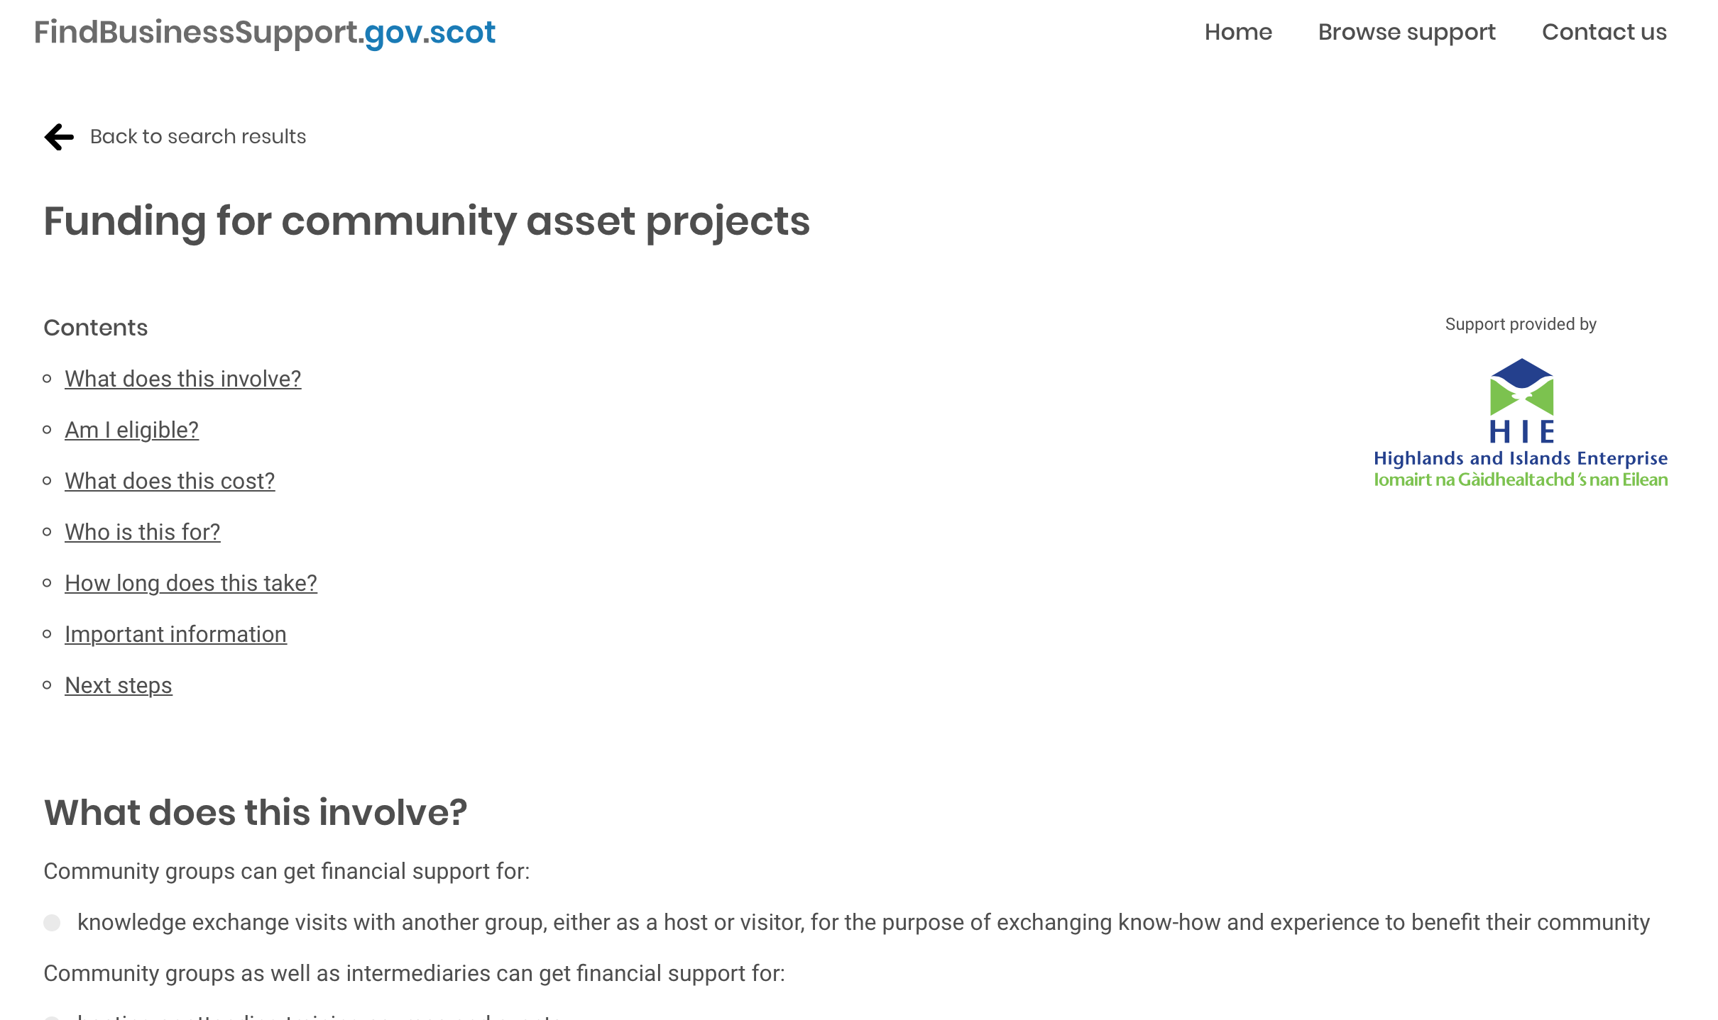
Individual Support Listing
The links at the top were well received
The CTA was very clear (Blue Button at the bottom)

Slide 8
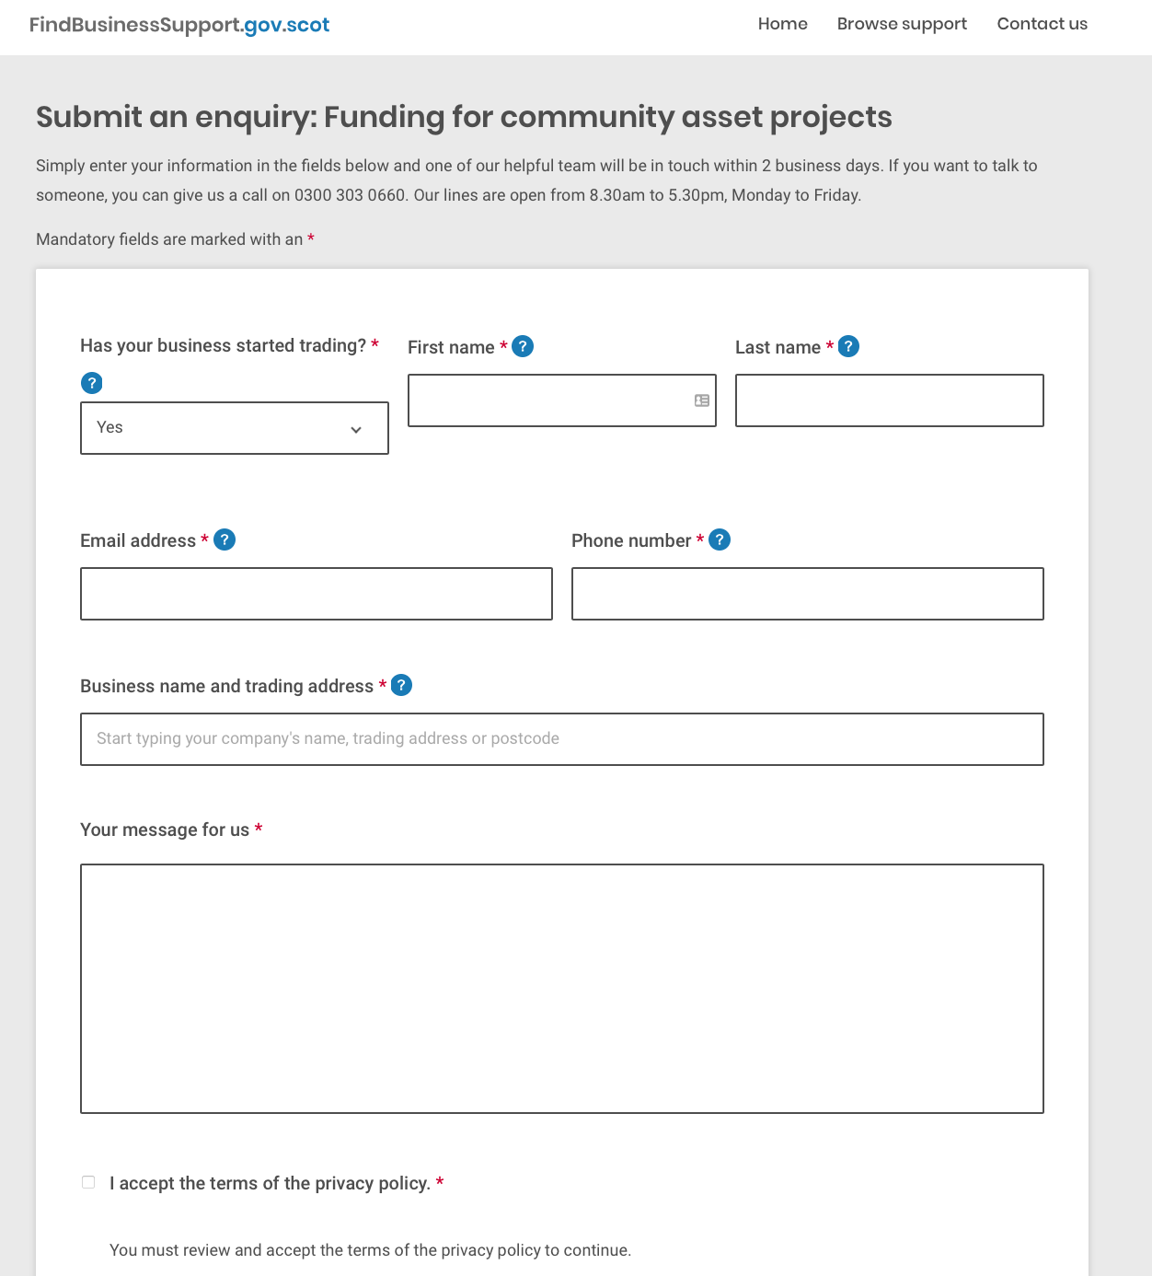
Submit an Enquiry
The brevity of the form was well received
The form did not trigger any negative responses ☺

Slide 9
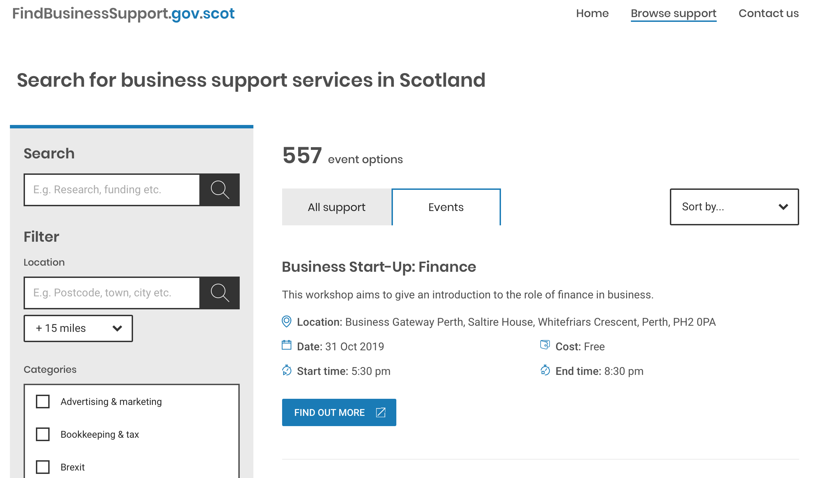
Event Listings
The events listing was well received.
The meta data under each event was appreciated as it meant that people did not have to go into each event to get the info
There was an issue with people being sent to another site to see the event details without them realizing what had happened OR expecting that to happen.
Suggestion: Make it more explicit that the CTA button takes you to another site

Slide 10
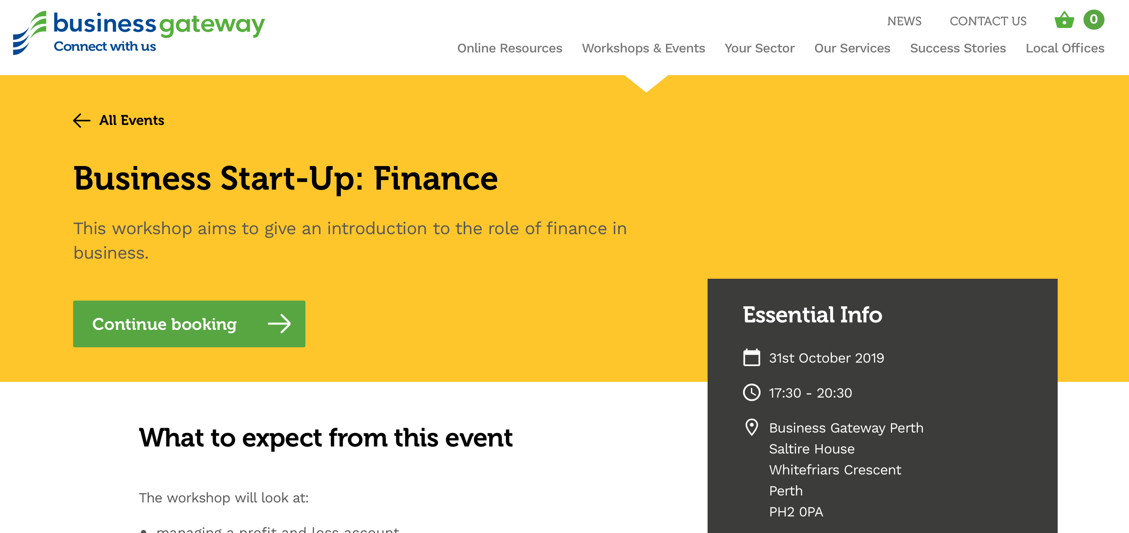
Individual Event Listing
The

Slide 11
SEP Feedback Quotes
Website has feel of being designed for a large screen rather than a laptop
Re home page “it looks plain it doesn’t get across who you are trying to get support from
“Not too cluttered it has all the things you need
Is it aimed at people who already have businesses or at those starting a business
Photo behind text difficult to read
Search page “clearer that the home page
Isn’t clear whether the phone number is free to call
Is there a logo who owns this website
is business gateway running the service
“Is there a reason you need to submit it 6 weeks before “ This was around having a transparent reason for statements
I would use this

Slide 12
fin

